Slide 1
JavaScript Conditional Statements
How to use Conditional Statements
Conditional statements are used to decide the flow of execution based on different conditions. If a condition is true, you can perform one action and if the condition is false, you can perform another action.

Slide 2
Different Types of Conditional Statements
There are mainly three types of conditional statements in JavaScript.
If statement
If…Else statement
If…Else If…Else statement

Slide 3
If statement
Syntax:
if (condition) { lines of code to be executed if condition is true }

Slide 4
<html>
<head>
<title>IF Statments!!!</title>
<script type="text/javascript">
var age = prompt("Please enter your age");
if(age>=18)
document.write("You are an adult <br />");
if(age<18)
document.write("You are NOT an adult <br />");
</script>
</head>
<body>
</body>
</html>

Slide 5
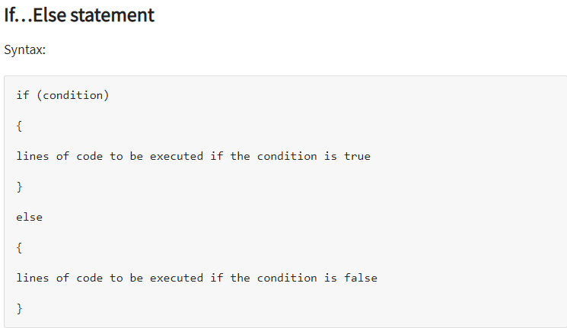

Slide 6
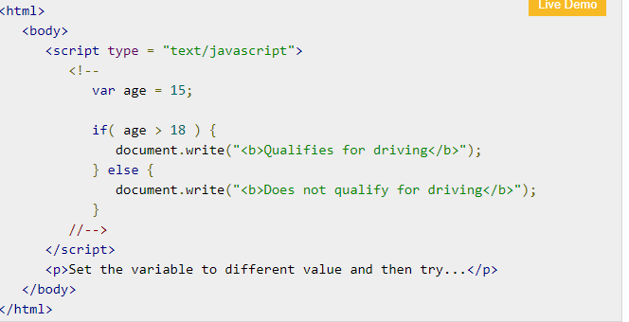

Slide 7
if...else if... statement
The if...else if... statement is an advanced form of if…else that allows JavaScript to make a correct decision out of several conditions.

Slide 8
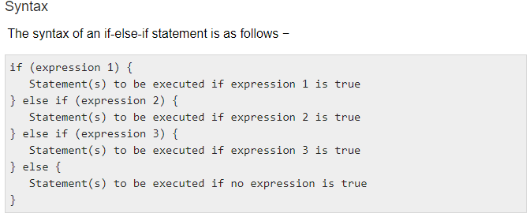

Slide 9
There is nothing special about this code. It is just a series of if statements, where each if is a part of the else clause of the previous statement. Statement(s) are executed based on the true condition, if none of the conditions is true, then the else block is executed.

Slide 10
Example
Try the following code to learn how to implement an if-else-if statement in JavaScript.

Slide 11
